Slide 1
Introduction to
Mathematical Programming
OR/MA 504
Chapter 6
Goal programming and Multiple Objective Optimization

Slide 2
Goal Programming and Multiple Objective Optimization
Chapter 6

Slide 3
Introduction
Most of the optimization problems considered to this point have had a single objective.
Often, more than one objective can be identified for a given problem.
  Maximize Return or Minimize Risk
  Maximize Profit or Minimize Pollution
These objectives often conflict with one another.
This chapter describes how to deal with such problems.

Slide 4
Goal Programming (GP)
Most LP problems have hard constraints that cannot be violated...
  There are 1,566 labor hours available.
  There is $850,00 available for projects.
In some cases, hard constraints are too restrictive...
  You have a maximum price in mind when buying a car (this is your “goal” or target price).
  If you can’t buy the car for this price you’ll likely find a way to spend more.
We use soft constraints to represent such goals or targets we’d like to achieve.

Slide 5
A Goal Programming Example:
Myrtle Beach Hotel Expansion
Davis McKeown wants to expand the convention center at his hotel in Myrtle Beach, SC.
The types of conference rooms being considered are:
Size (sq ft) Unit Cost
Small 400 $18,000
Medium 750 $33,000
Large 1,050 $45,150
Davis would like to add 5 small, 10 medium and 15 large conference rooms.
He also wants the total expansion to be 25,000 square feet and to limit the cost to $1,000,000.

Slide 6
Defining the Decision Variables
X₁ = number of small rooms to add
X₂ = number of medium rooms to add
X₃ = number of large rooms to add

Slide 7
Defining the Goals
Goal 1: The expansion should include approximately 5 small conference rooms.
Goal 2: The expansion should include approximately 10 medium conference rooms.
Goal 3: The expansion should include approximately 15 large conference rooms.
Goal 4: The expansion should consist of approximately 25,000 square feet.
Goal 5: The expansion should cost approximately $1,000,000.

Slide 8
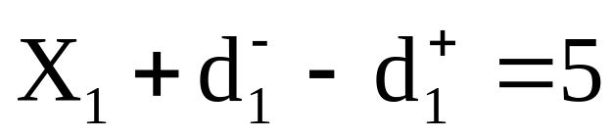
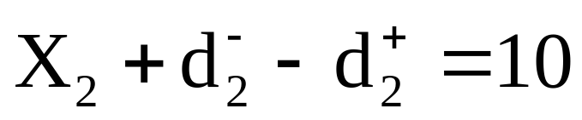
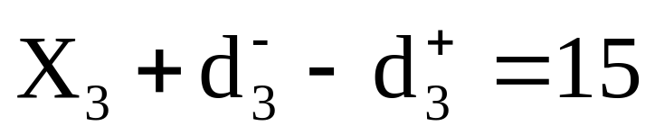
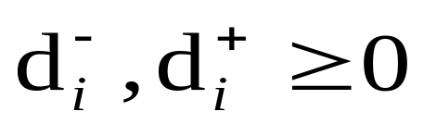
Defining the Goal Constraints-I
Small Rooms
Medium Rooms
Large Rooms
where

Slide 9
Defining the Goal Constraints-II
Total Expansion
Total Cost (in $1,000s)
where

Slide 10
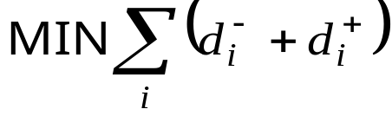
GP Objective Functions
There are numerous objective functions we could formulate for a GP problem.
Minimize the sum of the deviations:
Problem: The deviations measure different things, so what does this objective represent?

Slide 11
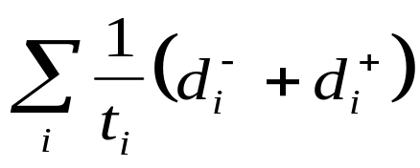
GP Objective Functions (cont’d)
Minimize the sum of percentage deviations
  MIN
  where t_{i} represents the target value of goal i
Problem: Suppose the first goal is underachieved by 1 small room and the fifth goal is overachieved by $20,000.
  We underachieve goal 1 by 1/5=20%
  We overachieve goal 5 by 20,000/1,000,000= 2%
  This implies being $200,000 over budget is just as undesirable as having one too few small rooms.
  Is this true? Only the decision maker can say for sure.

Slide 12
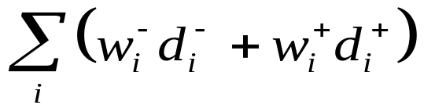
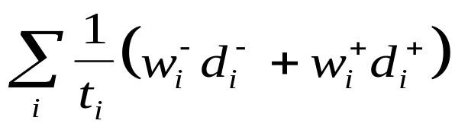
GP Objective Functions (cont’d)
Weights can be used in the previous objectives to allow the decision maker indicate
  desirable vs. undesirable deviations
  the relative importance of various goals
Minimize the weighted sum of deviations
  MIN
Minimize the weighted sum of % deviations
  MIN

Slide 13
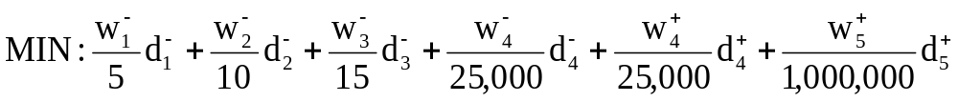
Defining the Objective
Assume
  It is undesirable to underachieve any of the first three room goals
  It is undesirable to overachieve or underachieve the 25,000 sq ft expansion goal
  It is undesirable to overachieve the $1,000,000 total cost goal
Initially, we will assume all the above weights equal 1.

Slide 14
Implementing the Model
See file Fig6-1.xls

Slide 15
Comments About GP
GP involves making trade-offs among the goals until the most satisfying solution is found.
GP objective function values should not be compared because the weights are changed in each iteration. Compare the solutions!
An arbitrarily large weight will effectively change a soft constraint to a hard constraint.
Hard constraints can be place on deviational variables.

Slide 16



The MiniMax Objective
Can be used to minimize the maximum deviation from any goal.
MIN: Q
etc...

Slide 17
Summary of Goal Programming
1. Identify the decision variables in the problem.
2. Identify any hard constraints in the problem and formulate them in the usual way.
3. State the goals of the problem along with their target values.
4. Create constraints using the decision variables that would achieve the goals exactly.
5. Transform the above constraints into goal constraints by including deviational variables.
6. Determine which deviational variables represent undesirable deviations from the goals.
7. Formulate an objective that penalizes the undesirable deviations.
8. Identify appropriate weights for the objective.
9. Solve the problem.
10. Inspect the solution to the problem. If the solution is unacceptable, return to step 8 and revise the weights as needed.

Slide 18
Multiple Objective Linear Programming (MOLP)
An MOLP problem is an LP problem with more than one objective function.
MOLP problems can be viewed as special types of GP problems where we must also determine target values for each goal or objective.
Analyzing these problems effectively also requires that we use the MiniMax objective described earlier.

Slide 19
An MOLP Example:
The Blackstone Mining Company
Blackstone Mining runs 2 coal mines in Southwest Virginia.
Monthly production by a shift of workers at each mine is summarized as follows:
Type of Coal Wythe Mine Giles Mine
High-grade 12 tons 4 tons
Medium-grade 4 tons 4 tons
Low-grade 10 tons 20 tons
Cost per month $40,000 $32,000
Gallons of toxic water produced 800 1,250
Life-threatening accidents 0.20 0.45
Blackstone needs to produce 48 more tons of high-grade, 28 more tons of medium-grade, and 100 more tons of low-grade coal.

Slide 20
Defining the Decision Variables
X₁ = number of months to schedule an extra shift at the Wythe county mine
X₂ = number of months to schedule an extra shift at the Giles county mine

Slide 21
Defining the Objective
There are three objectives:
  Min: $40 X₁ + $32 X₂ } Production costs
  Min: 800 X₁ + 1250 X₂ } Toxic water
  Min: 0.20 X₁ + 0.45 X₂ } Accidents

Slide 22
Defining the Constraints
High-grade coal required
  12 X₁ + 4 X₂ >= 48
Medium-grade coal required
  4 X₁ + 4 X₂ >= 28
Low-grade coal required
  10 X₁ + 20 X₂ >= 100
Nonnegativity conditions
  X₁, X₂ >= 0

Slide 23
Handling Multiple Objectives
If the objectives had target values we could treat them like the following goals:
Goal 1: The total cost of production should be approximately t₁.
Goal 2: The amount of toxic water produce should be approximately t₂.
Goal 3: The number of life-threatening accidents should be approximately t₃.
We can solve 3 separate LP problems, independently optimizing each objective, to find values for t₁, t₂ and t₃.

Slide 24
Implementing the Model
See file Fig6-2.xls

Slide 25
Summarizing the Solutions
X₂
12
11
Feasible Region
10
9
8
7
6
Solution 1
(minimum production cost)
5
Solution 2
(minimum toxic water)
4
3
2
Solution 3
(minimum accidents)
1
0
X₁
0
1
2
3
4
5
6
7
8
9
10
11
12
X₁
Solution X₁ X₂ Cost Toxic Water Accidents
1 2.5 4.5 $244 7,625 2.53
2 4.0 3.0 $256 6,950 2.15
3 10.0 0.0 $400 8,000 2.00

Slide 26
Defining The Goals
Goal 1: The total cost of productions cost should be approximately $244.
Goal 2: The gallons of toxic water produce should be approximately 6,950.
Goal 3: The number of life-threatening accidents should be approximately 2.0.

Slide 27
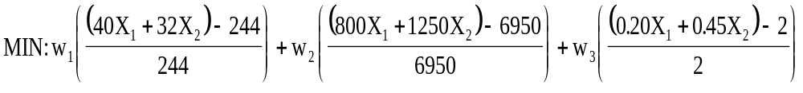
Defining an Objective
We can minimize the sum of % deviations as follows:
It can be shown that this is just a linear combination of the decision variables.
As a result, this objective will only generate solutions at corner points of the feasible region (no matter what weights are used).

Slide 28
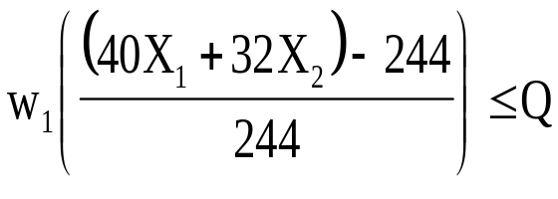
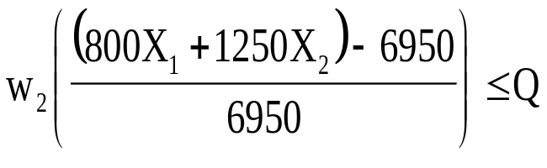
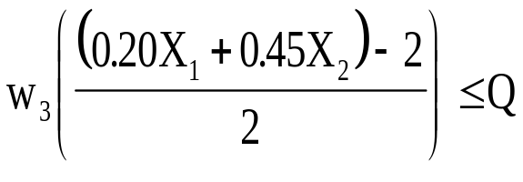
Defining a Better Objective
MIN: Q
Subject to the additional constraints:
This objective will allow the decision maker to explore non-corner point solutions of the feasible region.

Slide 29
Implementing the Model
See file Fig6-3.xls

Slide 30
Possible MiniMax Solutions
X₂
12
11
Feasible Region
10
9
8
7
6
w₁=10, w₂=1, w₃=1, x₁=3.08, x₂=3.92
5
4
w₁=1, w₂=10, w₃=1, x₁=4.23, x₂=2.88
3
2
1
w₁=1, w₂=1, w₃=10, x₁=7.14, x₂=1.43
0
X₁
X₁
0
1
2
3
4
5
6
7
8
9
10
11
12

Slide 31
Comments About MOLP
Solutions obtained using the MiniMax objective are Pareto Optimal.
Deviational variables and the MiniMax objective are also useful in a variety of situations not involving MOLP or GP.
For minimization objectives the percentage deviation is: (actual - target)/target
For maximization objectives the percentage deviation is: (target - actual)/target
If a target value is zero, use the weighted deviations rather than weighted % deviations.

Slide 32
Summary of MOLP
1. Identify the decision variables in the problem.
2. Identify the objectives in the problem and formulate them as usual.
3. Identify the constraints in the problem and formulate them as usual.
4. Solve the problem once for each of the objectives identified in step 2 to determine the optimal value of each objective.
5. Restate the objectives as goals using the optimal objective values identified in step 4 as the target values.
6. For each goal, create a deviation function that measures the amount by which any given solution fails to meet the goal (either as an absolute or a percentage).
7. For each of the functions identified in step 6, assign a weight to the function and create a constraint that requires the value of the weighted deviation function to be less than the MINIMAX variable Q.
8. Solve the resulting problem with the objective of minimizing Q.
9. Inspect the solution to the problem. If the solution is unacceptable, adjust the weights in step 7 and return to step 8.

Slide 33
End of Chapter 6

